Slide 1
Clubs and event management system
DBMS Project Presented to Dr Mamta Juneja UIET, Panjab University

Slide 2
Team members
Aryan Singh Dhiman (UE213020)
Eshita Negi (UE213036)
Gitansh Sehgal (UE213037)
Gourav Chahal (UE213039)
Hargun Kaur (UE213041)

Slide 3




Project menus
EXIT
ADMIN
MENUS
CLUB INFORMATION
CLUB MEETINGS
CLUB EVENTS
CLUB RECRUITMENTS

Slide 4
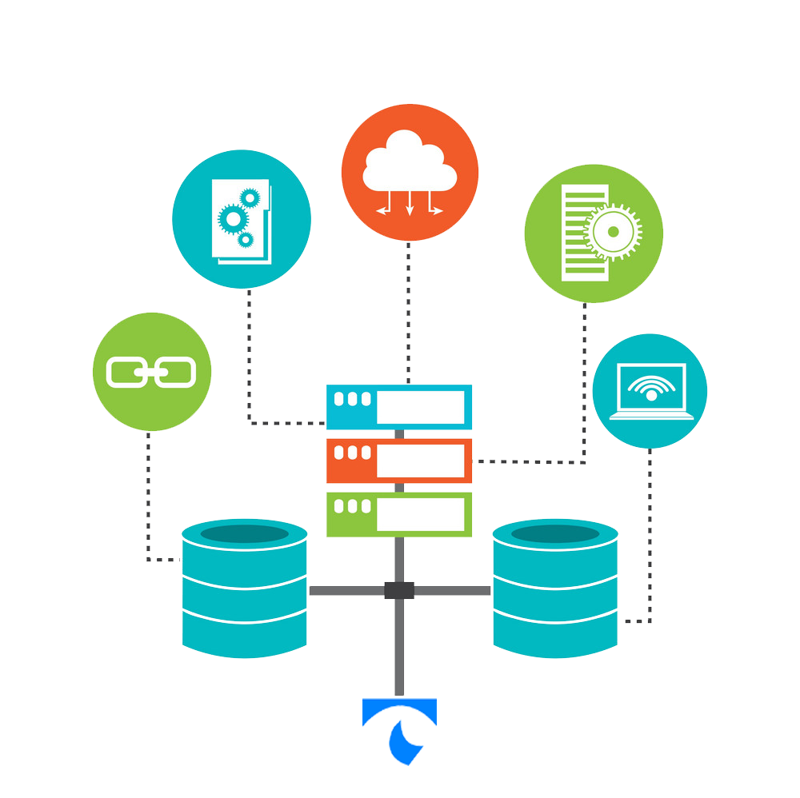
Use of Database Management System
DDL and DML
Views
Sequence
Index
Variable length array
Package
Cursor and string functions
Trigger

Slide 5
Entity relational model
Event
Co_convener_name
Co_convener
Name
Date
Description
has_co_convener
has_event
Club
Name
Convener
S_media
Description
Meeting
Recruitment
Date
Venue
Description
has_meeting
has_recruitment
Date
Venue

Slide 6
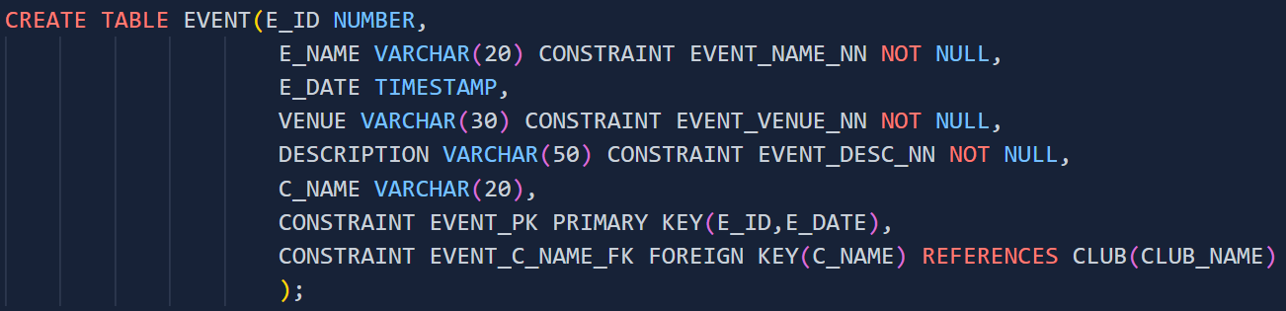
Use of SQL and PL/SQL Data Definition Language AND Data Manipulation Language
Implementation of ER model in the DBMS system was done using SQL DDL statements
Constraints were effectively used to model real life data.
DML statements were used in functions and procedure to process data.

Slide 7
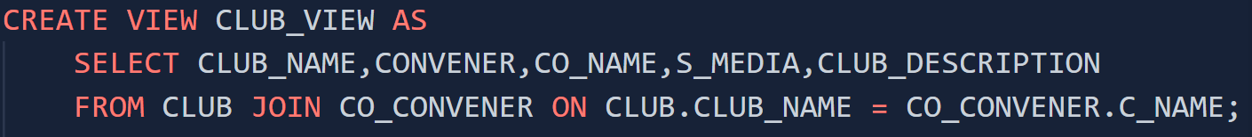
Use of SQL and PL/SQL Views
View and JOIN were used to combine the Club and the Co-convener table together to get a user friendly view.

Slide 8
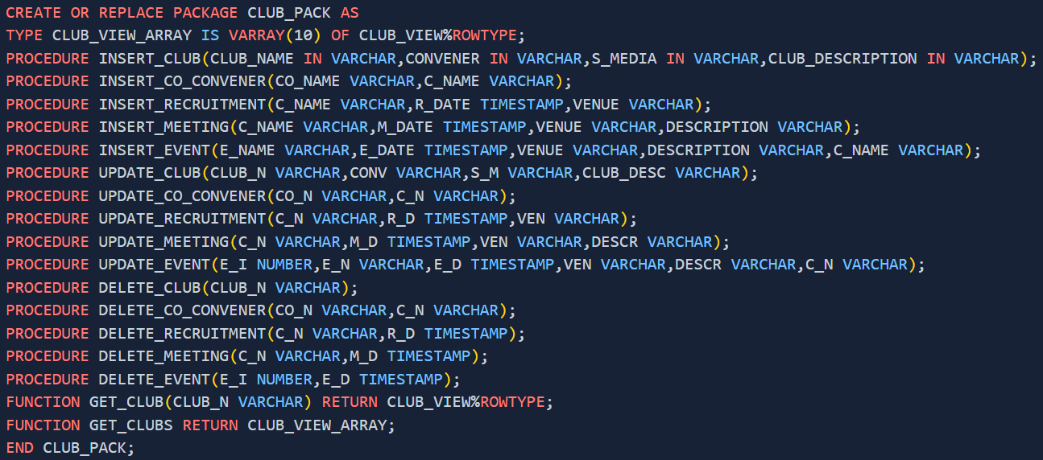
Use of SQL and PL/SQL packages
All the functions and procedures used to effectively interact with DBMS are grouped and provided for use using package “CLUB_PACK”.
Procedures for inserting data, updating data and deleting data are provided.
Functions for combining Club table and Co-convener table are also provided.

Slide 9
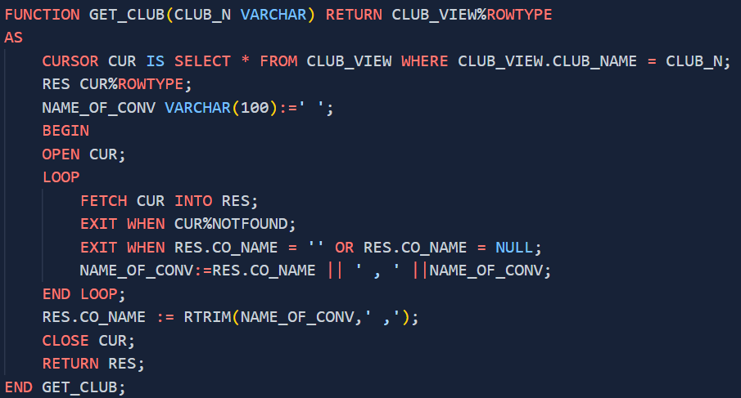
Use of SQL and PL/SQL cursor and string functions
Cursor was used in ‘GET_CLUB’ and ‘GET_CLUBS’ function to iterate over rows of ‘CLUB_VIEW’ view to combine the names of Co-conveners in a single column.
The concatenation operator and the ‘RTRIM’ function were used to format the co-convener string.

Slide 10
Use of SQL and PL/SQL variable length array
To facilitate effective transfer of data between the Oracle DBMS and Python Environment during the execution of ‘GET_CLUBS’ function Variable Length Array was used to hold all ‘CLUB_VIEW’ tuples.

Slide 11
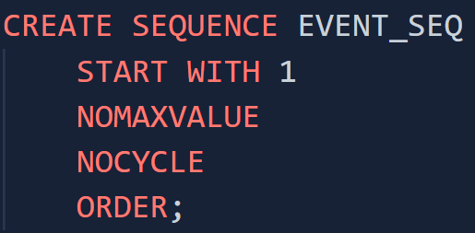
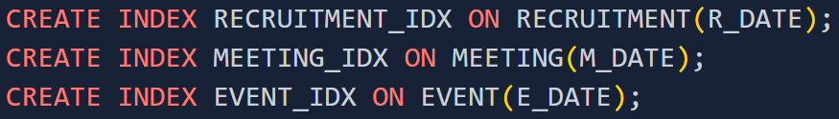
Use of SQL and PL/SQL sequence and index
‘EVENT_SEQ’ Sequence was used to generate ID’s for events.
Indexes were created on Date Column of all tables so as to facilitate quick access by date

Slide 12
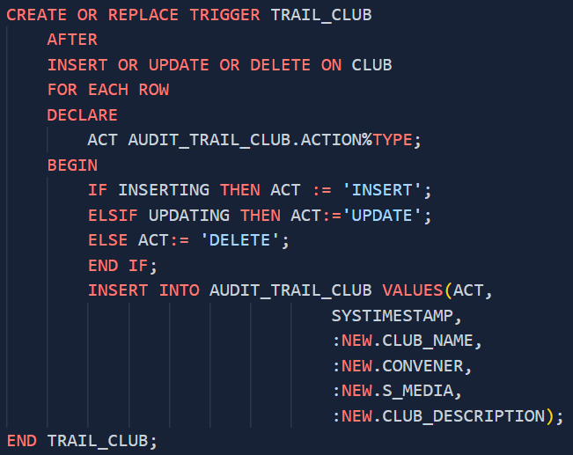
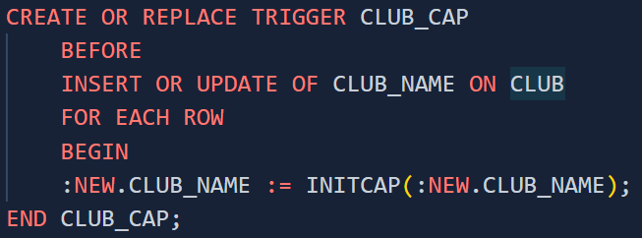
Use of SQL and PL/SQL triggers
Triggers were used for facilitating audit trails. Triggers for insert, update and delete were made for each table and the logs were stored in audit trail tables.
Another trigger (named ‘CLUB_CAP’) for formatting name of club before insertion and updation of club was created and made use of ‘Initcap’ function.

Slide 13
Project overview
MAIN MENU
CLUB MENU
CLUB INFO
CLUB MEETING
ADMIN
RECRUITMENT
LOGIN
CLUB INFO
CLUB MEETING
RECRUITMENT
SEARCH
INSERT/UPDATE/DELETE
EVENT
SEARCH
LOGIN
INSERT/UPDATE/DELETE

Slide 14
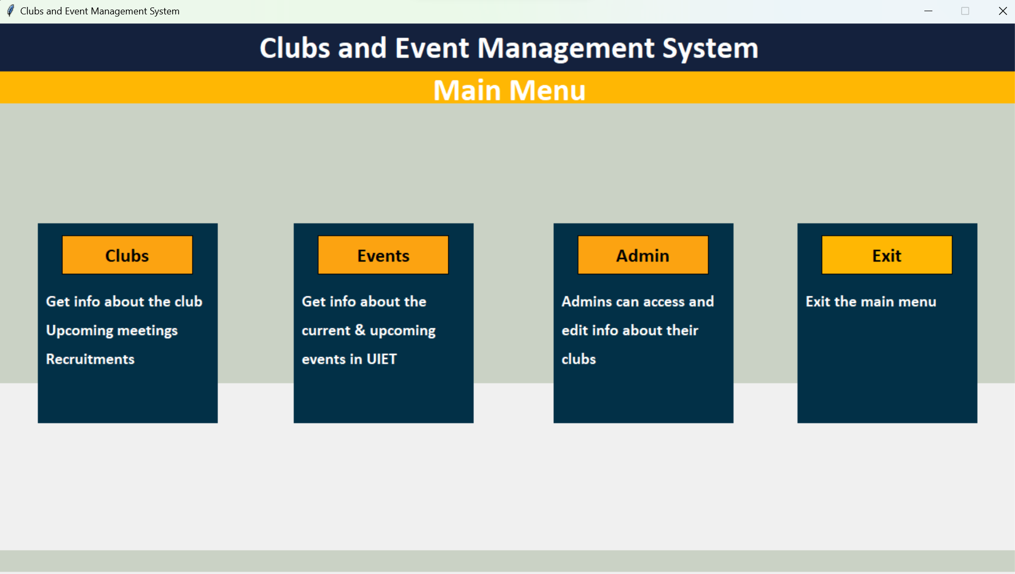
MAIN Menu

Slide 15
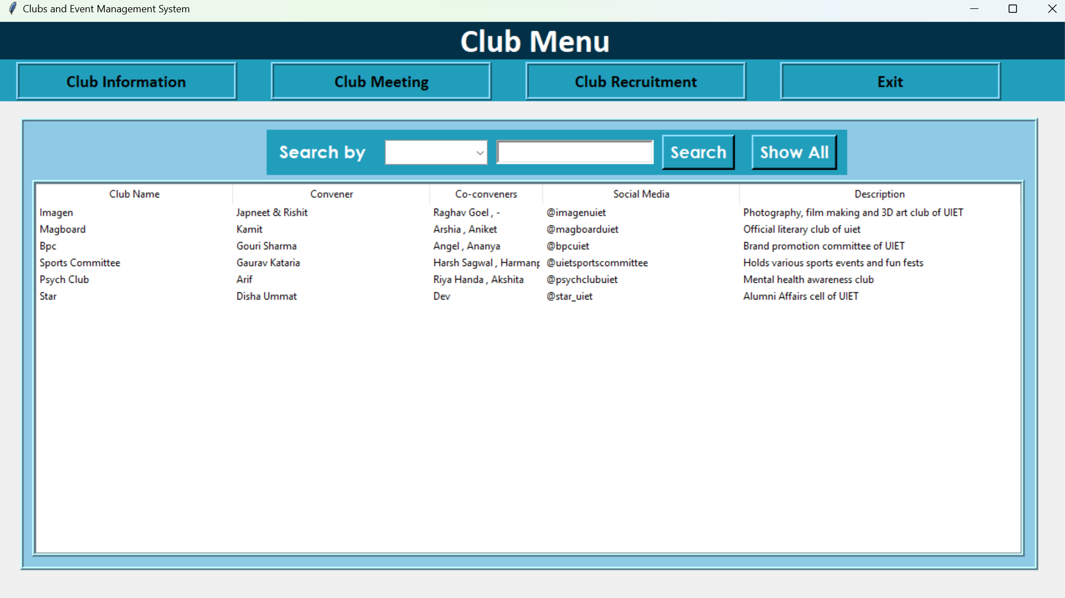
club Menu
In club menu we can get information about all clubs by using ‘Show All’ button

Slide 16
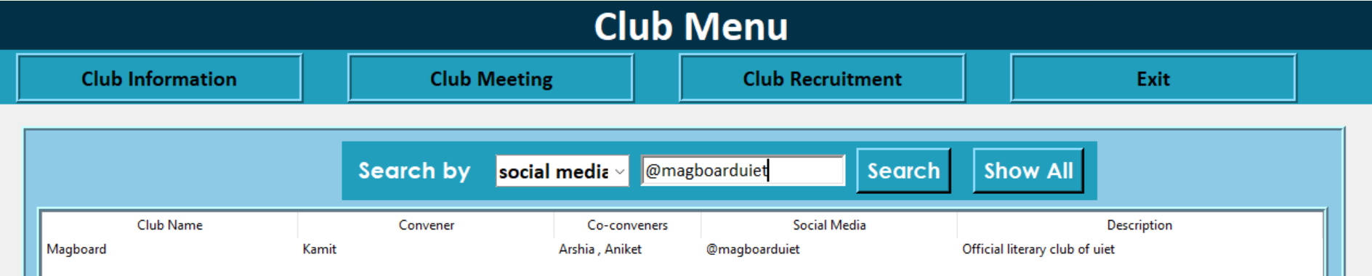
Club menu
Select option from dropdown menu
Enter the data
Press search button
Searching by a column:

Slide 17
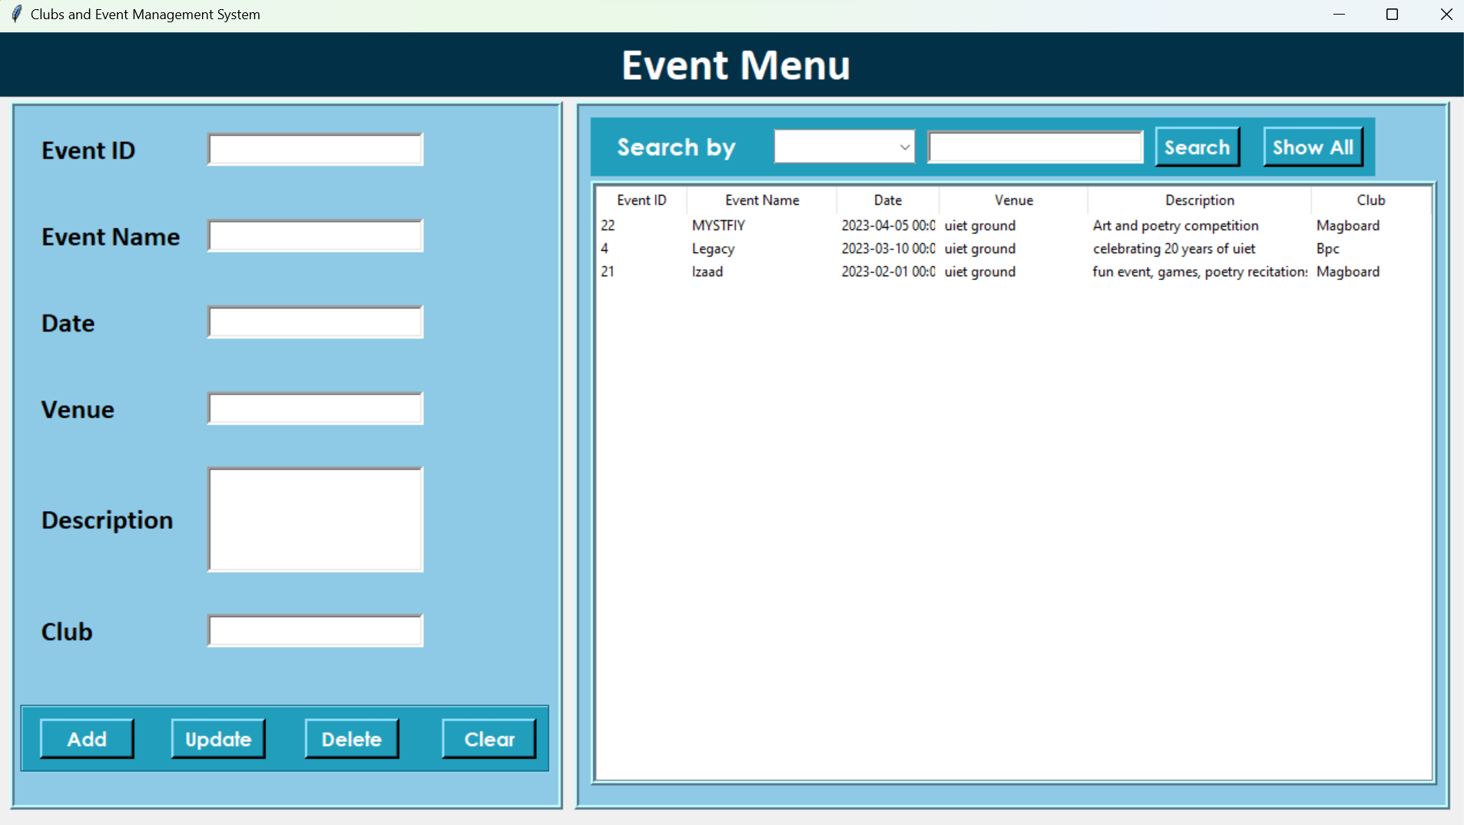
event Menu
In Event Menu we can get information about all events by using ‘Show All’ button

Slide 18
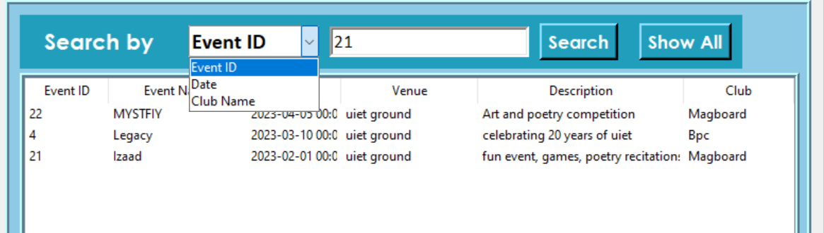
event Menu
Select option from dropdown menu
Enter the data
Press search button
Searching by a column:

Slide 19
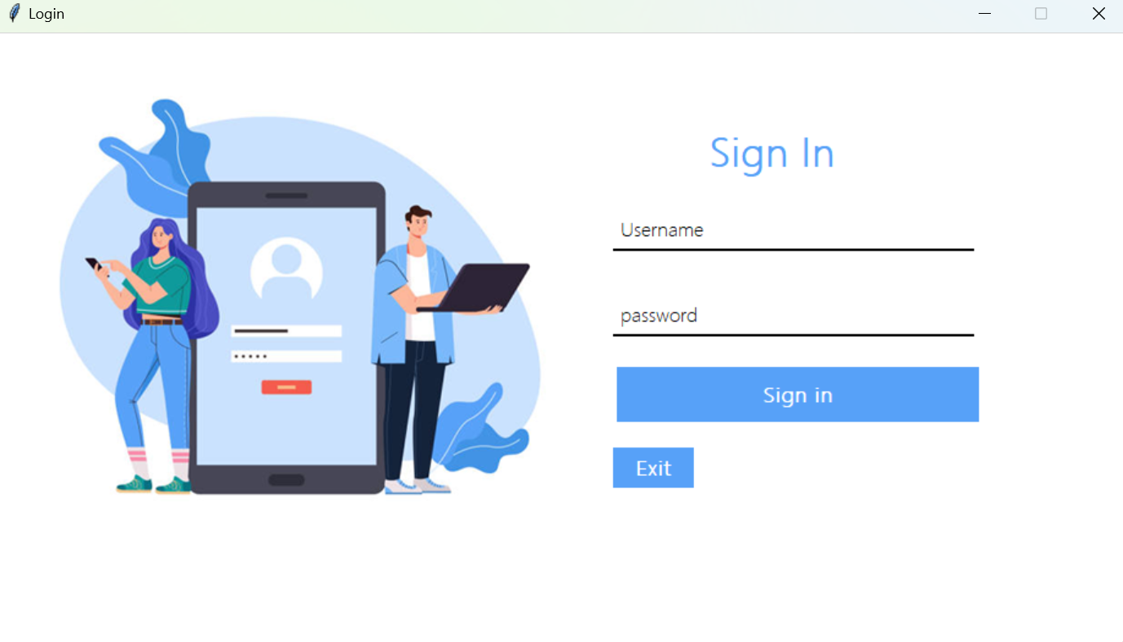
login
Before entering the admin section we need to login by entering username and password

Slide 20
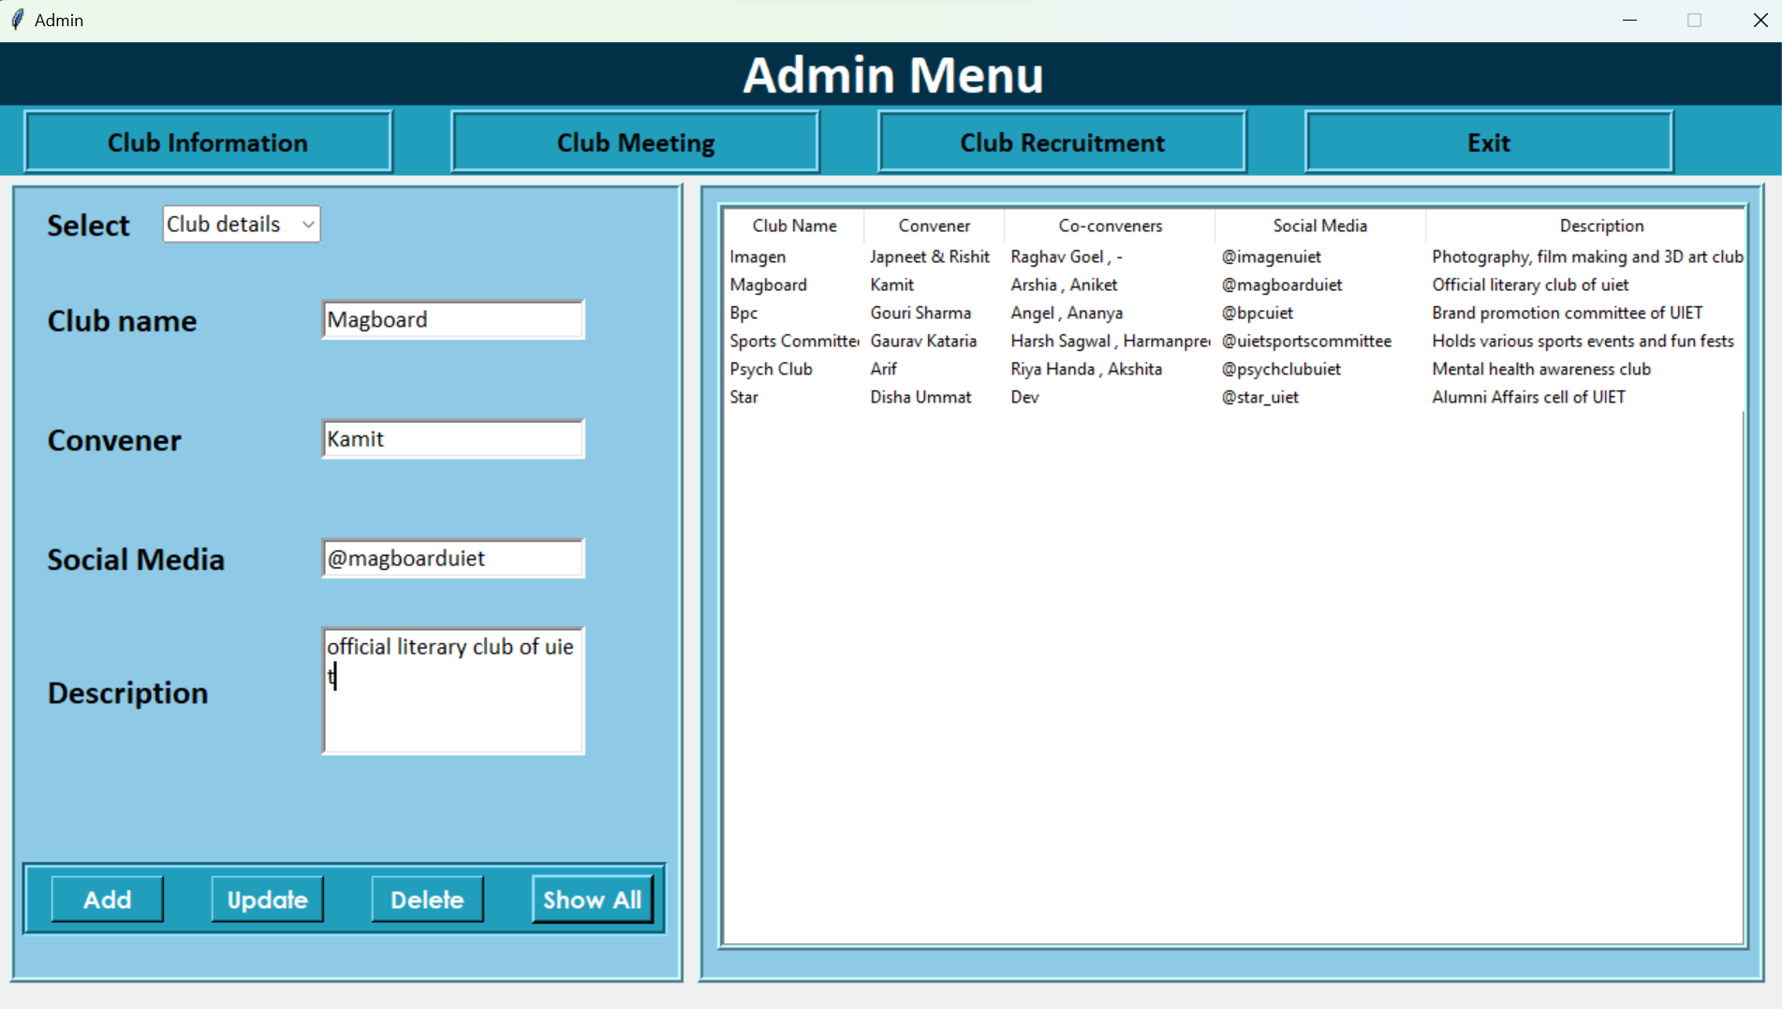
admin Menu

Slide 21

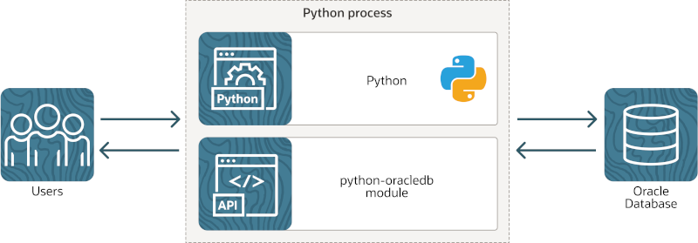
Role of Python-OracleDB
Python-OracleDB driver is the official Python library to connect with Oracle Databases.
It was used to call precompiled functions and procedures and to execute dynamic SQL queries.

Slide 22
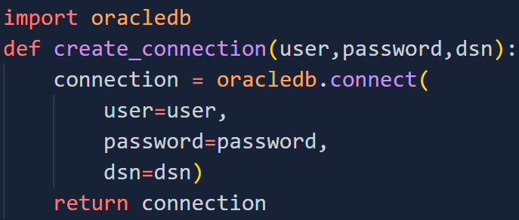
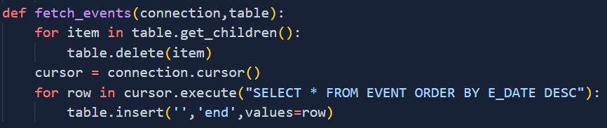
Examples of usage of python-oracledb driver
Using Python-OracleDB to connect to database:
Using Python-OracleDB to execute Dynamic SQL queries:

Slide 23
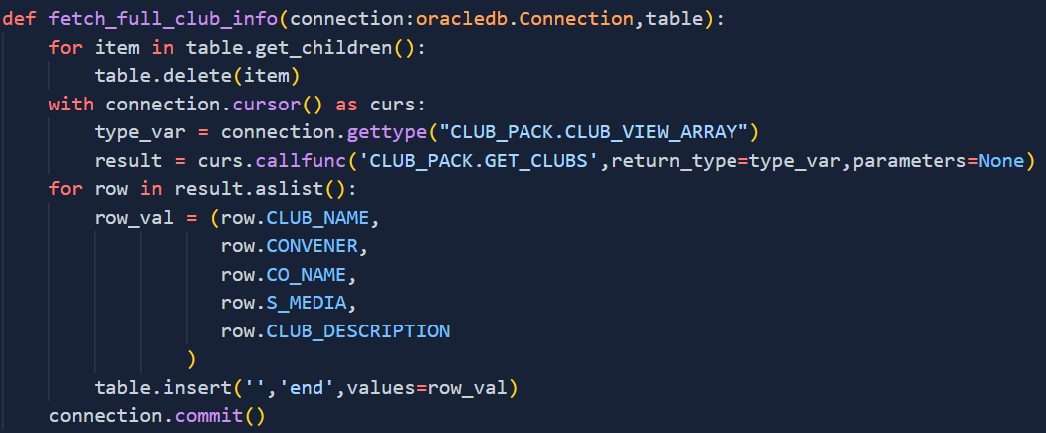
Using Python-OracleDB to call precompiled functions and procedures:

Slide 24

use of tkinter
The GUI for our project was made in tkinter which is the standard GUI library for python.
Various widgets like buttons, labels and text boxes are used in our GUI application
We used tkinter to create the following
Main window and child windows
Text boxes using Label
Buttons
Getting input by Entry widget
Drop down menus using Combobox
Displaying table using Treeview

Slide 25
THANK YOU

